Slide 1


Disjoint Sets
Given a set {1, 2, …, n} of n elements.
Initially each element is in a different set.
  {1}, {2}, …, {n}
An intermixed sequence of union and find operations is performed.
A union operation combines two sets into one.
  Each of the n elements is in exactly one set at any time.
A find operation identifies the set that contains a particular element.
Notes:
Application of trees (not binary trees) and simulated pointers. Simple application of simulated pointers; one that does not require an explicit storage management system.
In this application we are concerned with the time taken to perform an intermixed sequence of operations rather than the time for an individual operation.

Slide 2
Using Arrays and Chains
Best time complexity using arrays and chains is O(n + u log u + f), where u and f are, respectively, the number of union and find operations that are done.
Using a tree (not a binary tree) to represent a set, the time complexity becomes almost O(n + f) (assuming at least n/2 union operations).
Notes:
Number of union operations cannot exceed n-1.

Slide 3
A Set as a Tree
S = {2, 4, 5, 9, 11, 13, 30}
Some possible tree representations:
4
5
13
2
9
11
30
5
13
4
13
11
4
5
2
9
9
11
30
2
30

Slide 4
Result of A Find Operation
find(i) is to identify the set that contains element i.
In most applications of the union-find problem, the user does not provide set identifiers.
The requirement is that find(i) and find(j) return the same value iff elements i and j are in the same set.
4
2
9
11
30
5
13
find(i) will return the element that is in the tree root.

Slide 5
Strategy for find(i)
13
4
5
9
11
30
2
Start at the node that represents element i and climb up the tree until the root is reached.
Return the element in the root.
To climb the tree, each node must have a parent pointer.

Slide 6
Trees with Parent Pointers
7
13
4
5
8
3
22
6
9
11
30
2
10
1
20
16
14
12

Slide 7
Possible Node Structure
Use nodes that have two fields: element and parent.
  Use an array table[] such that table[i] is a pointer to the node whose element is i.
  To do a find(i) operation, start at the node given by table[i] and follow parent fields until a node whose parent field is null is reached.
  Return element in this root node.

Slide 8
Example
13
4
5
9
11
30
2
1
table[]
0
5
10
15
(Only some table entries are shown.)

Slide 9
Better Representation
Use an integer array parent[] such that parent[i] is the element that is the parent of element i.
13
4
5
9
11
30
2
1
parent[]
2
9
13
13
4
5
0
0
5
10
15

Slide 10
Union Operation
union(i,j)
  i and j are the roots of two different trees, i != j.
To unite the trees, make one tree a subtree of the other.
  parent[j] = i

Slide 11
Union Example
7
13
8
3
22
6
4
5
10
9
11
30
2
20
16
14
12
1
union(7,13)

Slide 12
The Union Function
void simpleUnion(int i, int j)
{parent[i] = j;}

Slide 13

Time Complexity Of simpleUnion()
O(1)

Slide 14
The Find Function
int simpleFind(int i)
{
while (parent[i] >= 0)
i = parent[i]; // move up the tree
return i;
}

Slide 15
Time Complexity of simpleFind()
Tree height may equal number of elements in tree.
  union(2,1), union(3,2), union(4,3), union(5,4)…
5
4
3
2
1
So complexity is O(u).

Slide 16

u Unions and f Find Operations
O(u + uf) = O(uf)
Time to initialize parent[i] = 0 for all i is O(n).
Total time is O(n + uf).
Worse than using a chain!
Back to the drawing board.

Slide 17
Smart Union Strategies
13
7
4
5
8
3
22
6
9
11
30
2
10
1
20
16
14
12
union(7,13)
Which tree should become a subtree of the other?

Slide 18
Height Rule
Make tree with smaller height a subtree of the other tree.
Break ties arbitrarily.
13
7
4
5
9
8
3
22
6
11
30
2
10
1
union(7,13)
20
16
14
12

Slide 19
Weight Rule
Make tree with fewer number of elements a subtree of the other tree.
Break ties arbitrarily.
7
13
8
3
22
6
4
5
9
10
11
30
2
20
16
14
12
1
union(7,13)

Slide 20
Implementation
Root of each tree must record either its height or the number of elements in the tree.
When a union is done using the height rule, the height increases only when two trees of equal height are united.
When the weight rule is used, the weight of the new tree is the sum of the weights of the trees that are united.

Slide 21
Height of A Tree
Suppose we start with single element trees and perform unions using either the height or the weight rule.
The height of a tree with p elements is at most floor (log₂p) + 1.

Slide 22
Sprucing Up The Find Method
7
13
8
3
22
6
4
5
9
g
10
f
11
30
e
2
20
16
14
12
d
1
a, b, c, d, e, f, and g are subtrees
a
b
c
find(1)
Do additional work to make future finds easier.

Slide 23
Path Compaction by Collapsing
Make all nodes on find path point to tree root.
find(1)
7
13
8
3
22
6
4
5
9
g
10
f
11
30
e
2
20
16
14
12
d
1
a, b, c, d, e, f, and g are subtrees
a
b
c
Makes two passes up the tree.

Slide 24
Time Complexity
Lemma 5.6 [Tarjan and Van Leeuwen]
Let T(f,u) be the maximum time required to process any intermixed sequence of f finds and u unions. Assume that u >= n/2.
k₁*(n + f*α(f+n, n)) <= T(f,u) <= k₂*(n + f*α(f+n, n))
where k₁ and k₂ are constants.
These bounds apply when we start with singleton sets and use either the weight or height rule for unions and any one of the path compression methods for a find.

Slide 25
Time Complexity
Ackermann’s function.
  A(i,j) = 2^{j}, i = 1 and j >= 1
  A(i,j) = A(i-1,2), i >= 2 and j = 1
  A(i,j) = A(i-1,A(i,j-1)), i, j >= 2
Inverse of Ackermann’s function.
  α(p,q) = min{z>=1 | A(z, p/q) > log₂q}, p >= q >= 1
Ackermann’s function的變形
n
n+f

Slide 26
Time Complexity
Ackermann’s function grows very rapidly as i and j are increased.
  A(2,4) = 2^{65,536}
The inverse function grows very slowly.
  α(p,q) < 5 until q = 2^{A(4,1)}
  A(4,1) = A(2,16) >>>> A(2,4)
In the analysis of the union-find problem, q is the number, n, of elements; p = n + f; and u >= n/2.
  u: number of union operations
  f: num. of find operations
For all practical purposes, α(p,q) < 5.
Notes:
The number of atoms in the Universe is about 10⁷⁹ and the number of photons and neutrinos is about 10⁸⁸. A(2,4) (and so also A(4,1)) dwarfs these numbers!

Slide 27
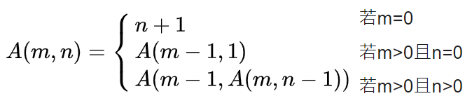

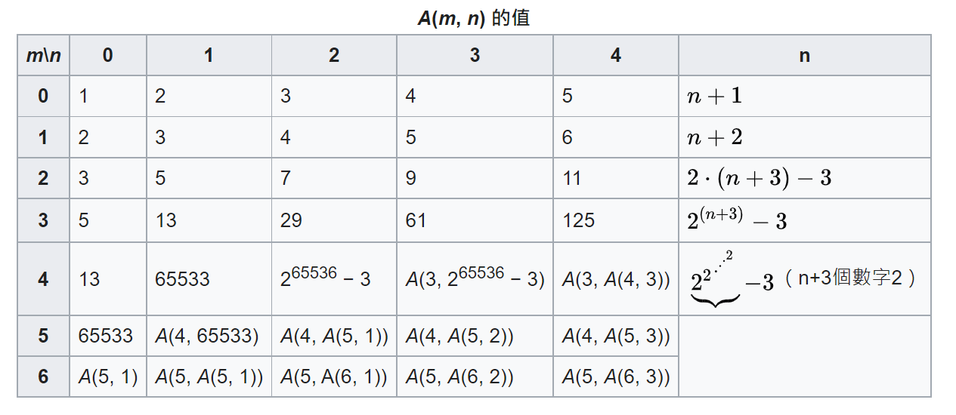
補充：Typical Ackermann Function

